Slide 1
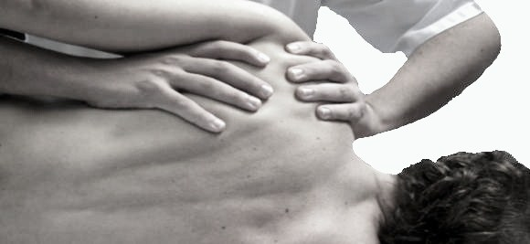
Muscle Energy Technique
(MET)
Dr. Sanket Mungikar
Dept. Of Musculoskeletal Physiotherapy
MGM Institute Of Physiotherapy
Chh.Sambhajinagar

Slide 2

Definition of MET
Muscle energy technique has been defined as a form of manipulative treatment in which the patients muscles are actively used on request from a precisely controlled position in a specific direction and against a distinctly executed counterforce – American Osteopathic Association

Slide 3
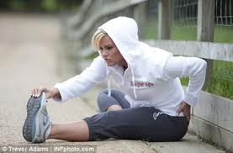
Uses of MET
According to American Osteopathic Association
  Mobilize joints in which movement is restricted
  Stretch tight muscle and fascia
  Improve local circulation

Slide 4
According to P E Greenman
  MET is used to lengthen a shortened, or contracted muscle
  To strengthen a physiologically weakened muscle or group of muscles
  To reduce localized edema
  To mobilize an articulation with restricted mobility

Slide 5
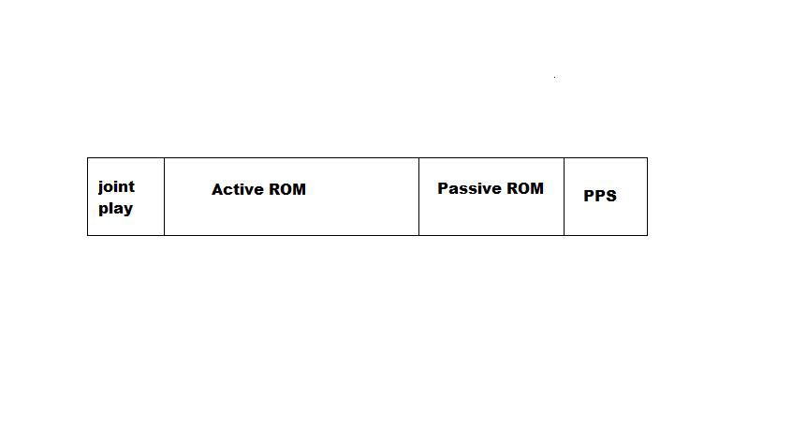
Barrier concept
Neutral
Position
Limit of active
ROM
Barrier
P A
Bind
  Moving towards the barrier
Ease
  Moving away from the barrier

Slide 6
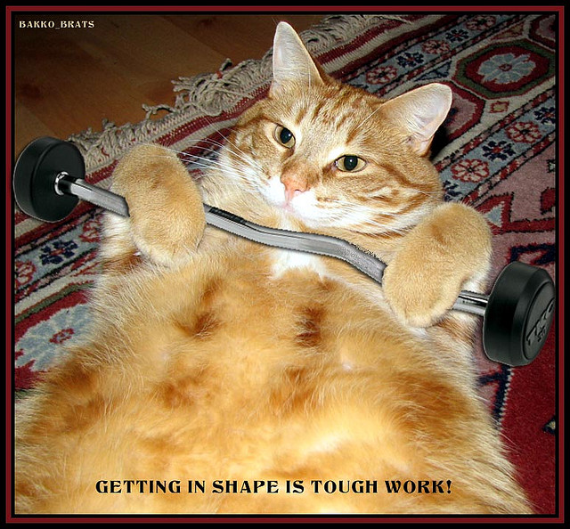

Slide 7
Technical Principles in MET
Muscle energy procedures attempt to shorten or lengthen the distance between the origin and insertion of certain muscles
The goals are to
  Strengthen the weaker side of an asymmetry
  Decreases the hypertonicity
  Lengthen muscle fiber
  Reduce the restraint of movement

Slide 8
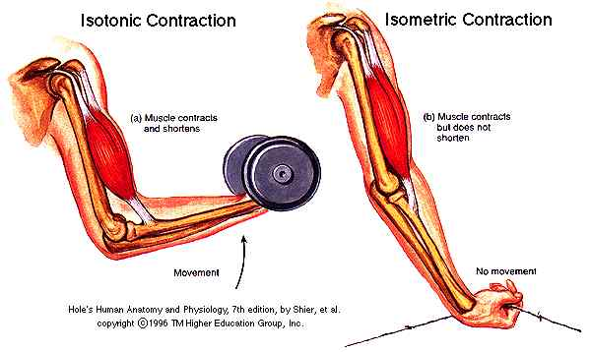
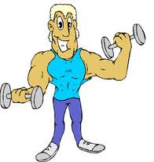
Muscle contractions are classified as
  Isometric contraction
  Isotonic concentric contraction
  Isotonic eccentric contraction (Isolytic)

Slide 9
Isometric Contraction
The distance between the origin and the insertion of the muscle remains the same as the muscle contracts
Neither the patients effort nor the therapist’s resistance win
This apparently resets the muscles proprioceptors as the tight muscle lengthens
OPERATOR’S FORCE = PATIENT’S EFFORT
(PIR or RI) ISOMETRICS

Slide 10
Isotonic Concentric Contraction
The overall length of the muscle shortens, approximating the origin and insertion.
Physiologically it is like the work of biceps lifting the glass of water from table to mouth.
The patients effort exceeds the physicians resistance. This method is helpful in building the muscle strength
OPERATOR’S FORCE < PATIENT’S EFFORT
ISOTONIC CONCENTRIC CONTRACTION

Slide 11
Isotonic Eccentric Contraction
The distance between the origin and insertion is increased
This type of contraction occurs when the biceps lowers the glass of water to the table without spilling it
In treatment mode, this type of muscle contraction occurs, “when a given resistance overcomes the muscle tension so that the muscle actually lengthens”
OPERATOR’S FORCE > PATIENT’S EFFORT
ISOTONIC ECCENTRIC CONTRACTION
or ISOLYTIC CONTRACTION

Slide 12
Physiological Principles of MET
PIR
  Mitchell Jr postulated that immediately following the isometric contraction the neuromuscular apparatus is in a refractory state during which passive stretching may be performed without encountering strong myotatic reflex opposition
  All the therapist needs to do is resist the contraction and then take up the slack in the fascias during the relaxed refractory period

Slide 13
Reciprocal Inhibition (RI)
  When a muscle is contracted its antagonist will be inhibited
  Due to inhibition antagonist muscle will relax immediately
  Thus the antagonists of shortened muscle or group of muscles may be isometrically contracted in order to achieve a degree of ease and additional movement in shortened tissues

Slide 14
Activating Forces
Extrinsic Forces
Intrinsic Forces
These forces make the technique work
Extrinsic forces come from outside the patient
  Physician effort
Intrinsic come from within the patient
  Active muscular contraction
  Active patient positioning
  Respiratory cooperation

Slide 15
Lewit’s PIR
PIR technique, as described by Lewit, is a method of reducing or relaxing muscle tone in acute situations, in muscles that demonstrate muscle hypertonicity and with muscles containing trigger points
  Hypertonic muscle taken to barrier
  Patient contracts away from the barrier(agonists contract) 5 to 10 seconds
  Patient uses 10 -30 % of his available strength
  Patient is asked to relax (exhale)and stretch to limit

Slide 16
Types of MET
Isometric contraction – reciprocal inhibition
Isometric contraction – post isometric relaxation
Isotonic concentric contraction
Isolytic eccentric contraction

Slide 17
Isometric Contraction – Reciprocal Inhibition
Indications
  Relaxing muscular spasm or contraction
  Mobilizing restricted joints
  Preparing joint for manipulation
Contraction starting point
  At the restriction barrier
Modus operandi
  Affected muscles not employed, antagonists used in isometric contraction obliging shortened muscles to relax via reciprocal inhibition
  Patient is attempting to push through the barrier of restriction against the operators precisely matched counter force

Slide 18
Forces
  Operators and patient forces are matched
  20%to 50%
Duration of contraction
  7 to 10 seconds initially, increasing up to 20 seconds
Action following contraction
  Area is taken to its new restriction barrier without stretch after ensuring complete relaxation. Perform movement to new barrier on an exhalation
Repetitions
  3 to 5 times or until no further gain in ROM is possible

Slide 19
Isometric Contraction – Post Isometric Relaxation
Indications
  Relaxing muscular spasm or contraction
  Mobilizing restricted joints
  Preparing joint for manipulation
Contraction starting point
  At resistance barrier
Modus operandi
  Affected muscle(agonists) are used in the isometrics contraction, therefore the shortened muscles subsequently relax via post isometric relaxation
  Operator is attempting to push through barrier of restriction against the patients precisely matched counterforce

Slide 20
Forces
  Operators and patient forces are matched
  20% to 50%
Duration of contraction
  7 to 10 seconds initially, increasing up to 20 seconds
Action following contraction
  Area is taken to its new restriction barrier without stretch after ensuring complete relaxation. Perform movement to new barrier on an exhalation
Repetitions
  3 to 5 times or until no further gain in ROM is possible

Slide 21
Isotonic Concentric Contraction
Indications
  Toning weakened musculature
Contraction starting point
  In a mid range easy position
Modus operandi
  The contracting muscle is allowed to do so , with some resistance form the operator

Slide 22
Forces
  Patients force greater than operators force
  Patient uses maximal effort available, but is force is built slowly
  Operator maintains constant degree of resistance
Duration of contraction
  3 to 4 seconds
Repetitions
  5 to 7 times or more if appropriate

Slide 23
Isolytic Eccentric Contraction
Indications
  Stretching tight, fibrotic musculature
Contraction starting point
  A little short of restriction barrier
Modus operandi
  Muscle to be stretched is contracted and is prevented from doing so by operators greater force and contraction is overcome and reversed so that the contracting muscle is stretched

Slide 24
Forces
  Operators force is greater than patients
Duration of contraction
  2 to 4 seconds
Repetitions
  3 to 5 times if discomfort is not excessive

Slide 25
Sequential Steps of MET
Based on an accurate diagnosis, muscle energy procedure to lengthen shortened muscles and/or fascial elements follows these principles:
The physiotherapist positions the bone, joint or body part appropriately at the position of initial resistance.
The physiotherapist instruct the patient about his/her participation and helps the patient to obtain an effective direction of movement for limb, trunk or head

Slide 26
The physiotherapist directs the patient to contract the appropriate muscle or muscle group
The physiotherapist uses counterforce in opposition to and equal to the patients muscle contraction
The physiotherapist maintains force until an appropriate patient contraction is perceived at the critical articulation or area

Slide 27
The patient is directed to gently cease the contraction
The physiotherapist allows the patient to relax sense the tissue relaxation
The physiotherapist takes up the slack permitted by the procedure. The slack is allowed by the decreased tension in tight muscle allowing it be passively lengthened

Slide 28
Steps 1 -8 are repeated 1 to 2 times until best possible ROM is obtained
The physiotherapist reevaluates the original dysfunction

Slide 29
Amount of Force
Muscle energy technique is not a wrestling match.
The amount force and counterforce are governed by
  The length and strength of the muscle group involved
  The ability of the patient to accurately pull the body part in the direction you desire to move
  Patients symptoms
A small amount of force should be used at the beginning ,which can be increased if necessary

Slide 30
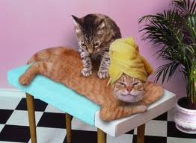

Slide 31
Asymmetrical Muscle Strength
Asymmetry of motion means possibility of asymmetrical strength
If asymmetry of muscle strength is present, employ a method of increase the strength of the weak muscle group
Progressive resistance exercises are used to strengthen weakened groups of muscles

Slide 32
If weakness and shortness occur in different muscle groups but on the same side, attend the shortness first.
Jull and Janda feel the agonists spontaneously increase their strength if the shortened or hypertonic fibers are lengthened

Slide 33
Indications/Uses
Whenever somatic dysfunction is present
Whenever there is a need to restore mobility and stability
Normalize abnormal neuromuscular relationship
Improve local circulation and respiratory function
Lengthen and/or normalize restricted muscles and fascia

Slide 34
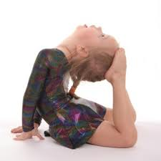
To reduce edema
Mobilize restricted joint
Restore mobility of motion segment
Retain global movement patterns
Stretch fibrotic tissue

Slide 35
Contraindications
Fracture
Severe sprain
Severe strain
Suspected Pathology (until confirmed dx)
Joint instability
Tumour
Infection in immediate underlying tissue

Slide 36
Uncooperative patient
Unresponsive patient
Those who cannot or will not follow directions
MET should not be requested of a very painful muscle or muscle group

Slide 37
Common Errors
By physiotherapist
  Inaccurate diagnosis
  Inaccurate localization of corrective forces, incorrect position of joints
  Inaccurate instruction to patient
By patient
  Incorrect force
  Incorrect direction
  Incorrect duration of patient’s effort

Slide 38
Dosage
The dosage is dependent on the intensity of the patient’s efforts in producing muscle contraction
The amount of patient effort may vary from simple muscle twitch to a maximum muscle contraction.
Duration may vary from a fraction of seconds to several seconds
Usually 3 -7 repetitions of muscles effort for each session can be performed

Slide 39
Side Effects
Muscle energy techniques are quite safe
With PIR, post treatment soreness and stiffness can occur (esp. with inexperience)

Slide 40
Evaluation of musculoskeletal pain
Factors responsible for :
Acquired postural imbalances .
Pattern of use stress
(occupational,recreational).
Inborn imbalances (short limb,birth injury).
Repetitive strain from body.
Emotional stress factors .
Trauma ,inflammation.
Disuse ,immobilization.
Climatic stress.
Nutritional deficiency (infection)

Slide 41
Postural muscle and phasic muscle
Postural muscle :predominance of type 1 fiber.
Phasic muscle :predominance in type 2 fiber .
 | Postural muscle | Phasic muscle
Type | Slow twitch -red | Fast twitch –white
Respiration | Anaerobic | Aerobic
Function | Static /supportive | Phasic /active
Dysfunction | Shorten | Weaken
Treatment | Stretch/relax | Facilitate /strengthen

Slide 42
Pattern of imbalance
Lengthened /underactive stabilizer | Overactive synergist | Shortened antagonist
Gluteus medius | TFL ,Piriformis, quadratus lumborum | Thigh antagonist
Gluteus maximus | Iliocostalis lumborum,hamstring | Iliopsoas ,rectus femoris
Transverse abdominis | Rectus abdominis | Iliocostalis lumborum
Lower trapezius | Levator scapulae,lower trapezius . | Pectoralis major
Deep neck flexor | SCM | Sub occipital
Serratus anterior | Pectoralis major and minor. | Rhomboids
Diaphragm |  | Scalenes ,pectoralis minor

Slide 43
Janda has described this pattern of shortness and weakness in upper cross and lower cross syndrome .
Upper cross syndrome :this is releated to altered position of head,neck ,shoulders .
Occiput and c1/c2 will hyper extend ,with head being pushed forward.
lower cervical and 4th thoracic vertebrae will be posturally stressed as result.
Rotation and abduction of scapula .
Altered axis of glenoid fossa leads to humerus stabilised by levator scapular,upper trapezius .
Lower cross syndrome :pelvis tip forward in frontal plane .
Flexing hip joint and producing lumbar lordosis and stress at L5-S1 level .
Further stress on sagittal plane in with quadritus lumborum tightens and gluteus maximus and medius become weaken.
Lateral core set become unstable leads to back pain .

Slide 44
.
Lower cross syndrome :pelvis tip forward in frontal plane .
Flexing hip joint and producing lumbar lordosis and stress at L5-S1 level .
Further stress on sagittal plane in with quadritus lumborum tightens and gluteus maximus and medius become weaken.
Lateral core set become unstable leads to back pain .

Slide 45
Upper cross syndrome
All tighten and short | All weaken
Pectoralis major ,minor . | Lower and middle trapezius
Upper trapezius | Serratus anterior and rhomboids
Levator scapulae
Sternomastoid
Lower cross syndrome
All tighten and short | All weaken
Hip flexors | Abdominal and gluteal muscles
Iliopsoas ,rectus femoris
TFL ,short adductors
Erector spine group of trunk

Slide 46
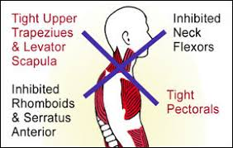
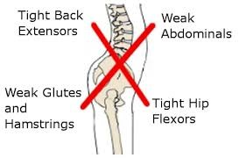

Slide 47
.
THANK YOU

